Slide 1

Student Details
Name: Aryan Dhiren Jagani
Email ID: aryanjagani09@gmail.com
College name: shah and anchor kutchhi engineering college
College state: Maharashtra
Internship domain and internship start and end date: artificial intelligence/12-06-2023 to 24-07-2023
Candid picture:

Slide 2

Mental fitness tracker
WHAT IS MENTAL FITNESS?
Mental fitness refers to the ability to cope with life's challenges, manage stress, and maintain overall well-being. It encompasses a range of factors such as emotional resilience, cognitive flexibility, and social connectedness.
Mental fitness is important because it affects every aspect of our lives, from our relationships to our work performance. Poor mental fitness can lead to a range of negative outcomes such as depression, anxiety, and burnout. In fact, according to the World Health Organization, depression is now the leading cause of disability worldwide.

Slide 3
AGENDA
Personal well-being: The primary agenda behind creating a mental fitness tracker model could be to help individuals monitor and improve their mental well-being. By tracking various factors such as mood, stress levels, sleep patterns, and cognitive performance, individuals can gain insights into their mental health and make informed decisions about their self-care routines.
Mental health support: A mental fitness tracker model can provide valuable data for mental health professionals, allowing them to assess their patients' progress, identify patterns, and tailor treatment plans more effectively. It can act as a supplementary tool to aid therapists in monitoring their clients remotely, providing more personalized care and support.
Research and data analysis: Collecting aggregated data from a large number of users can be invaluable for researchers studying mental health trends and patterns on a larger scale. Analyzing the data can help identify common triggers, risk factors, and effective interventions for mental health conditions. This research can lead to advancements in the field of mental health and the development of new treatments and interventions.
Corporate wellness programs: Some companies may develop mental fitness trackers as part of their employee wellness programs. The aim could be to promote mental well-being in the workplace, reduce stress, and enhance productivity. These trackers can provide insights into employees' stress levels, work-life balance, and overall mental health, enabling organizations to implement targeted interventions and support systems.
Commercial interests: Companies in the digital health industry may develop mental fitness trackers as a product or service to generate revenue. They may offer premium features or subscription plans to monetize the app, providing users with enhanced functionalities, personalized insights, and access to mental health experts.

Slide 4
PROJECT OVERVIEW
The mental fitness tracker model is designed to monitor and support individuals' mental well-being by tracking various factors related to mental health. The project aims to provide insights, personalized recommendations, and resources to help individuals improve their mental well-being and maintain a healthy lifestyle.
Overall, the mental fitness tracker model aims to empower individuals in understanding and managing their mental well-being. By combining data tracking, analysis, and personalized recommendations, it provides a comprehensive tool for individuals to take an active role in their mental health and make informed decisions towards achieving and maintaining a balanced and healthy lifestyle.

Slide 5
WHO ARE THE END USERS of this project?
1. Individuals: The primary end users are individuals who are interested in monitoring and improving their mental well-being. They may use the mental fitness tracker to gain insights into their mood, stress levels, sleep patterns, cognitive performance, and other relevant factors. The tracker can help individuals make informed decisions about self-care, set goals, and track their progress over time.
2. Mental health professionals: Mental fitness trackers can be valuable tools for mental health professionals such as therapists, psychologists, and psychiatrists. These professionals can utilize the data collected by the tracker to gain a better understanding of their clients' mental health, assess their progress, and provide more personalized care. The tracker can assist in remote monitoring, early intervention, and adjusting treatment plans as necessary.
3. Researchers: Mental fitness trackers can provide researchers with large-scale data sets for studying mental health trends, patterns, and interventions. Researchers can analyze the aggregated data to identify common factors related to mental health, explore correlations, and develop evidence-based practices. The insights gained from the tracker can contribute to advancements in the field of mental health research.
4. Employers and organizations: In the context of corporate wellness programs, employers and organizations may be the end users of mental fitness trackers. They can utilize the trackers to support their employees' mental well-being, monitor stress levels, and implement targeted interventions. The trackers can provide insights into employees' mental health and help organizations create supportive work environments.
5. App developers and service providers: If the mental fitness tracker is developed as a product or service, the app developers or service providers themselves can be considered end users. They develop and maintain the tracker, incorporating user feedback, adding features, and ensuring its usability and effectiveness. They may also use the tracker to gather data for research or commercial purposes.

Slide 6

YOUR SOLUTION AND ITS VALUE PROPOSITION
The mental fitness tracker project is based on a model that helps individuals track and improve their mental fitness. The model consists of four main components: self-awareness, mindfulness, resilience, and growth mindset.
Self-awareness involves understanding one's thoughts, emotions, and behaviors. Mindfulness involves being present in the moment and focusing on one's thoughts and feelings without judgment. Resilience involves bouncing back from challenges and setbacks. Growth mindset involves believing that one can improve and grow through effort and learning.

Slide 7
The mental fitness tracker project model offers numerous benefits for improving mental wellness. Firstly, it allows individuals to track their daily activities and monitor their progress towards achieving their goals. This helps to increase self-awareness and motivation, which are key components of good mental health. Secondly, the model provides personalized recommendations based on an individual's data, which can help them make informed decisions about their lifestyle choices. For example, if someone is not sleeping enough, the model may recommend that they aim to get more sleep each night. Finally, the model can also be used by healthcare professionals to provide tailored interventions for patients with mental health conditions, such as depression or anxiety.
Case studies have shown that using a mental fitness tracker can lead to significant improvements in mental wellbeing. For example, one study found that individuals who used a mental fitness tracker reported lower levels of stress and anxiety after just four weeks. Another study found that using a mental fitness tracker helped individuals to identify triggers for their negative emotions and develop coping strategies to manage them. Overall, the mental fitness tracker project model has the potential to revolutionize the way we approach mental health and wellbeing.

Slide 8
How did you customize the project and make it your own
Customizing the Mental Fitness Tracker Project was a challenging and rewarding experience. By personalizing the project to my own needs and interests, I was able to gain a deeper understanding of the concepts and techniques involved in building a mental fitness tracker.
One of the key ways I customized the project was by incorporating additional features and metrics beyond what was initially provided. I also experimented with different visualization techniques to better understand my data and identify trends over time.
Through this process, I learned a great deal about the importance of personalization in mental health tracking. Everyone's needs and experiences are unique, and it's important to tailor a mental fitness tracker to fit those individual needs. I also gained a deeper appreciation for the power of data visualization in understanding and interpreting complex data sets.

Slide 9
MODELLING
Polynomial regression: Polynomial regression is a type of regression analysis that models the relationship between the independent variable(s) and the dependent variable as an nth degree polynomial function. It is an extension of simple linear regression, which assumes a linear relationship between the variables.
Random Forest: Random Forest is a popular ensemble learning algorithm used for both classification and regression tasks. It is based on the concept of decision trees. Random Forest combines multiple decision trees and aggregates their predictions to make more accurate and robust predictions. Each decision tree is trained on a random subset of the training data, and the final prediction is obtained through majority voting (for classification) or averaging (for regression) of the individual tree predictions. Random Forest helps reduce overfitting and improves generalization performance.
Decision Tree: A decision tree is a simple yet powerful predictive model that uses a tree-like structure to make decisions or predictions. It consists of nodes and branches, where each node represents a decision based on a specific feature or attribute, and each branch represents the possible outcomes or paths based on that decision. The decision tree recursively partitions the data based on the selected features until reaching a leaf node, which provides the final prediction or decision.

Slide 10
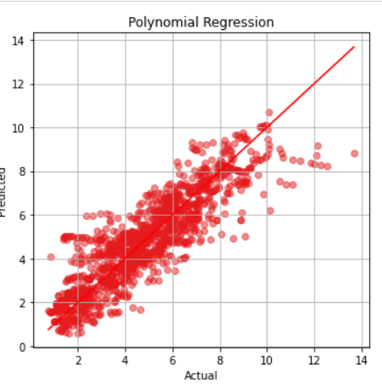
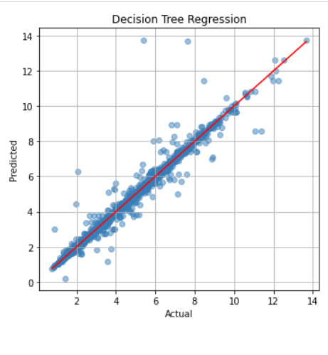
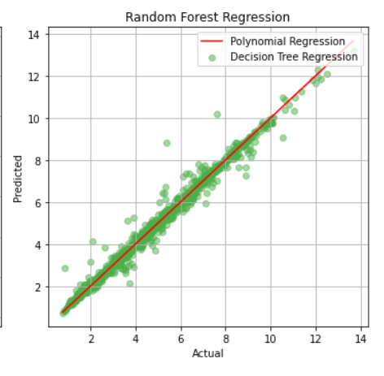
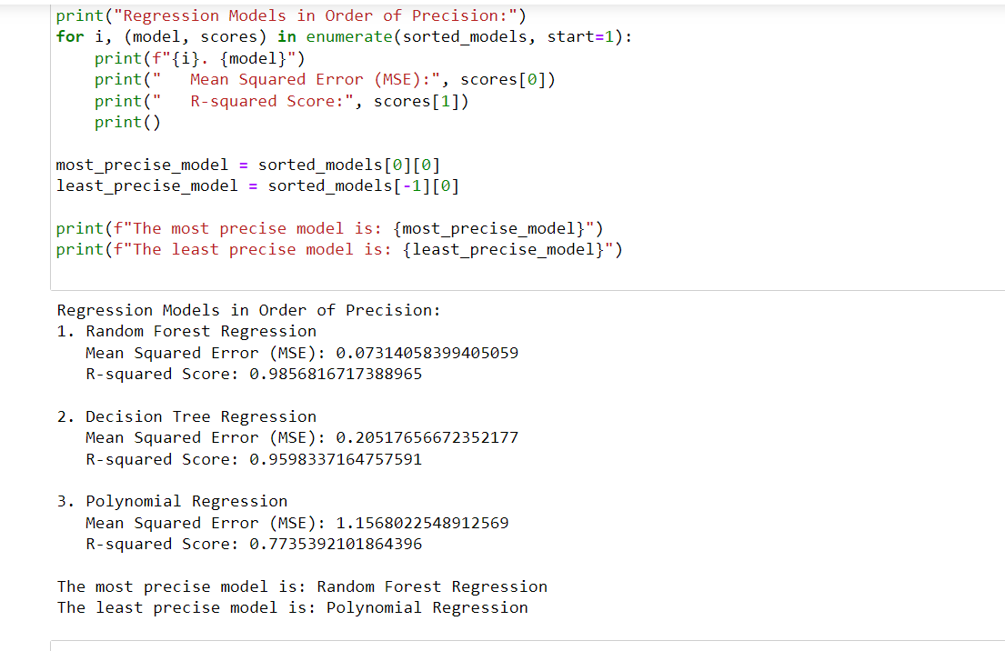

Slide 11
Results
Regression Models in Order of Precision:
1. Random Forest Regression:
Mean Squared Error (MSE): 0.07314058399405059
R-squared Score: 0.9856816717388965
2. Decision Tree Regression:
Mean Squared Error (MSE): 0.20517656672352177
R-squared Score: 0.9598337164757591
3. Polynomial Regression:
Mean Squared Error (MSE): 1.1568022548912569
R-squared Score: 0.7735392101864396
The most precise model is: Random Forest Regression
The least precise model is: Polynomial Regression

Slide 12
links
https://github.com/ARYANJAGANI/Mentalfitnesstracker

